Slide 1
Operative Vaginal Delivery Skills for Residents using Simulation Training
Frederick Friedman, Jr., MD
Ceyda Oner, MD
George Alex Trivette, MD
Department of Obstetrics, Gynecology, and Reproductive Science
Icahn School of Medicine at Mount Sinai
New York, NY
Presenting Author: frederick.friedman@mssm.edu

Slide 2
Introduction:
The frequency of operative vaginal deliveries (OVDs) has been declining throughout the United States. Several efforts are underway to reverse this trend with the hope of reducing cesarean sections and improving patient outcomes. For low frequency procedures, simulation has become the standard method of teaching. We describe a program consisting of a didactic session with a hands-on practical to improve the knowledge base and skill set of residents for OVDs.

Slide 3
Methods
Obstetrics and Gynecology residents at a single Institution were recruited for participation. Subjects provided baseline survey data including demographics, clinical experience (with OVDs), and subject knowledge. Following a didactic session, a hands-on practical was conducted using a mannequin. After the simulation, participants completed a post-training quiz and survey.

Slide 4
Results
A total of 22 residents completed the study. There was significant improvement in knowledge, as tested by pre-and post-didactic session scores (p<0.0001). This was observed regardless of the training level or experience of the resident. With a single hands-on practical half of residents were able to independently apply correctly the forceps, and 82% were able to employ the correct vector. Similarly 90% of residents used proper technique with vacuum-assisted vaginal delivery.

Slide 5
Exam Scores: Pre vs Post Didactic

Slide 6
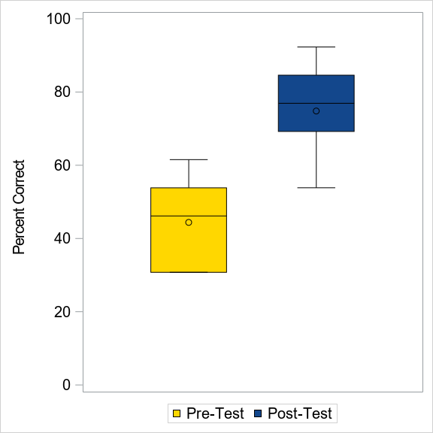
Exam Results Pre & Post Didactic

Slide 7
Exam Results by Resident Year

Slide 8
Exam Results by Resident Experience

Slide 9
Conclusion
Our educational program improved the knowledge base and skill set of residents for OVDs. All participating residents found this program to be worthwhile and enjoyable. Future efforts will involve repetition of the program to determine knowledge retention. We hope that the skills learned translate to improved performance and confidence in managing patients, and improved patient outcomes.

